Slide 1

Decoding Gamer Preferences: Steam Game Recommendations
Section27 Final Project Group 3: Mark Tian
Seojung Park
Yifan Xie
Young Kim
Lucas Yang

Slide 2
Agenda
01
02
03
04
05
Data Description
Problem Statement
games.csv Dataset
users.csv Dataset
recommendations.csv Dataset
Problem 1-4
Why is this big data？
Methods & Results
Volume
Variety
Value
Variety
Word Count Analysis
Time Series Analysis
Conclusion
Engagement Drives Recommendations
Model's Performance
Implications for Developers
Affirmation of Big Data's Value

Slide 3
01
Data Description

Slide 4
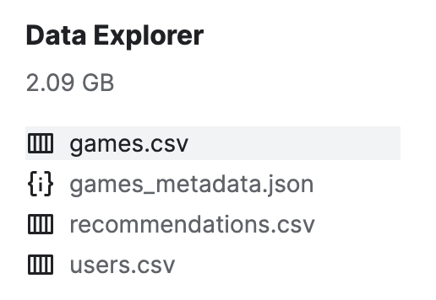
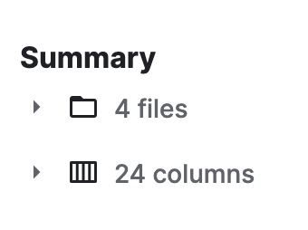
Data Description
games.csv Dataset:
Total number of records: 50,872
Total columns: 13
Column names: app_id, title, date_release, win, mac, linux, rating, positive_ratio, user_reviews, price_final, price_original, discount, steam_deck
Data types: Integers, Booleans, Strings
users.csv Dataset:
Total records: 13,786,778
Total columns: 3
Column names: user_id, products, reviews
Data types: Integers
recommendations.csv Dataset:
Total records: 38,354,101
Total columns: 8
Column names: app_id, helpful, funny, date, is_recommended, hours, user_id, review_id
Data types: Integer, Boolean, Strings

Slide 5
02
Problem Statement

Slide 6
Problem Statement
Problem 1: How does the word count relate to other variables? What is the most popular word used for the game title?
Problem 2: What kind of trend over the past years can we discover? Is there any meaningful insights we can get from there?
Problem 3: Does the number of reviews gradually increase accordingly as the number of games owned increases?
Problem 4: Which predictions affect the decision of recommended or not the most?

Slide 7
03
Why is this big data？

Slide 8
Why is this big data？
Volume
Our dataset is extremely large, which suggests that capturing the massive amount of data from extensive interactions within the Steam gaming community.
Variety
The dataset contains a variety of data types covering a range of information such as title, platform compatibility, pricing details, providing multifaceted insights into the gaming ecosystem.
Value
This data has great potential to extract valuable insights, for example it allows us to understand the factors that influence user engagement and game success, not just pricing strategies.
Variety
Although the gaming industry is known for its dynamic nature, the dataset still captures this rapid evolution and reflects well the fast pace of changes in gaming trends and preferences.

Slide 9
04
Methods & Results

Slide 10



Primary Method:
Data Analysis
Visualization
Visualize the result

Slide 11
Word Count Analysis
Problem 1: How does the word count relate to other variables?

Slide 12
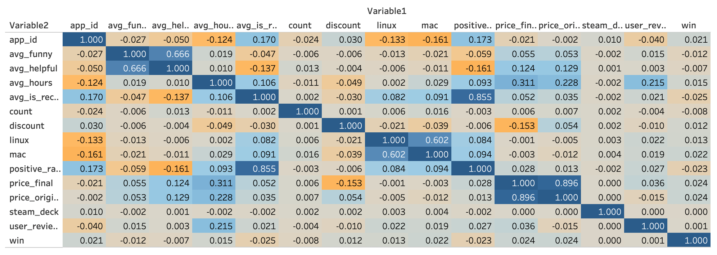
Correlation Matrix

Slide 13
Correlation Matrix

Slide 14
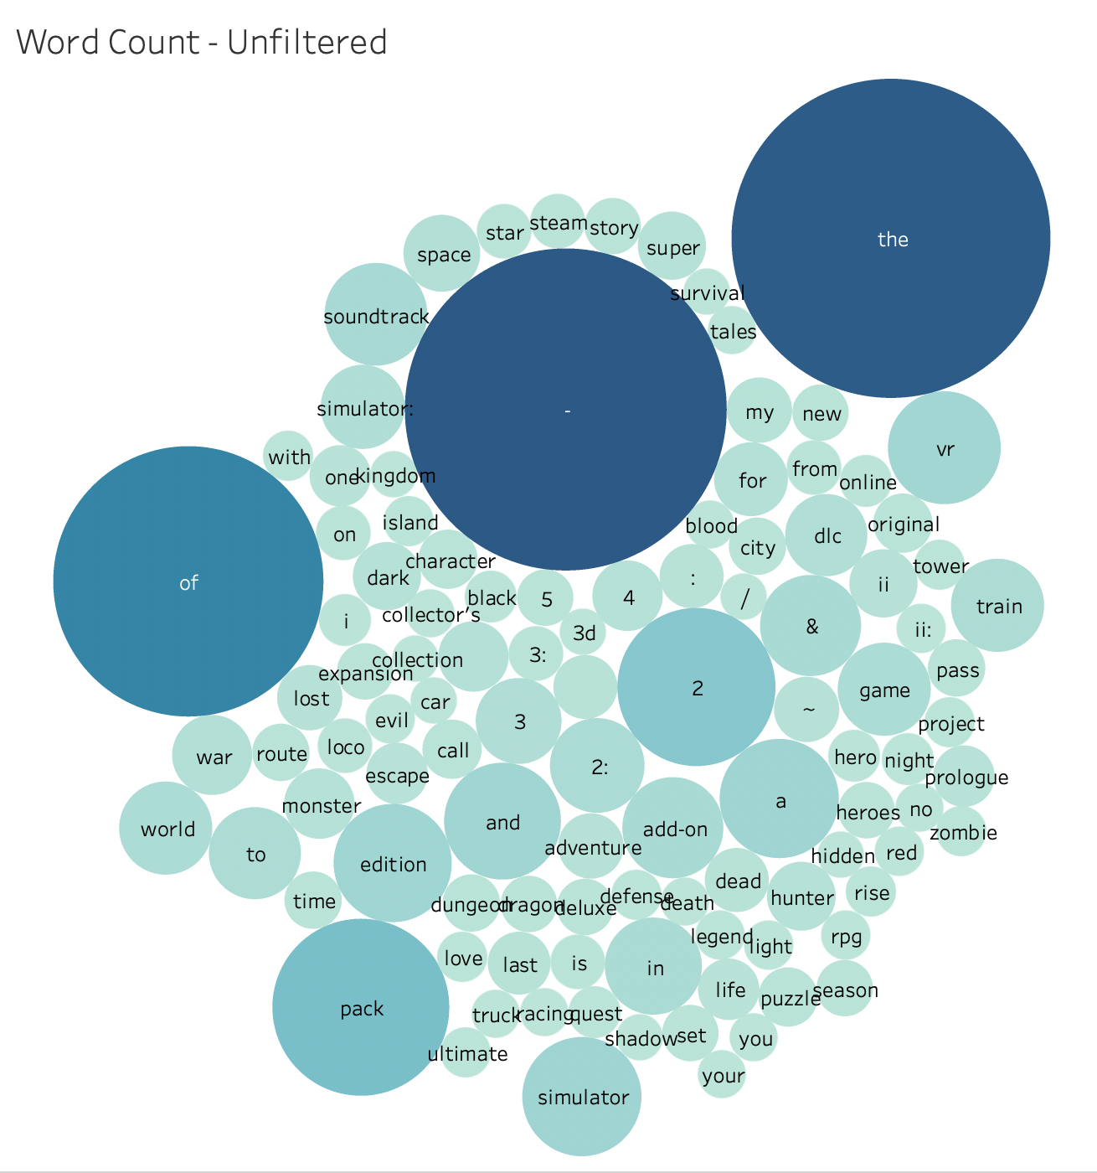
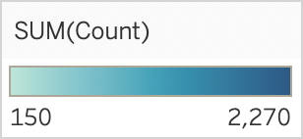
Word Count : Unfilterd
Tableau Visualization
Numbers
Articles, Prepositions
Symbols

Slide 15
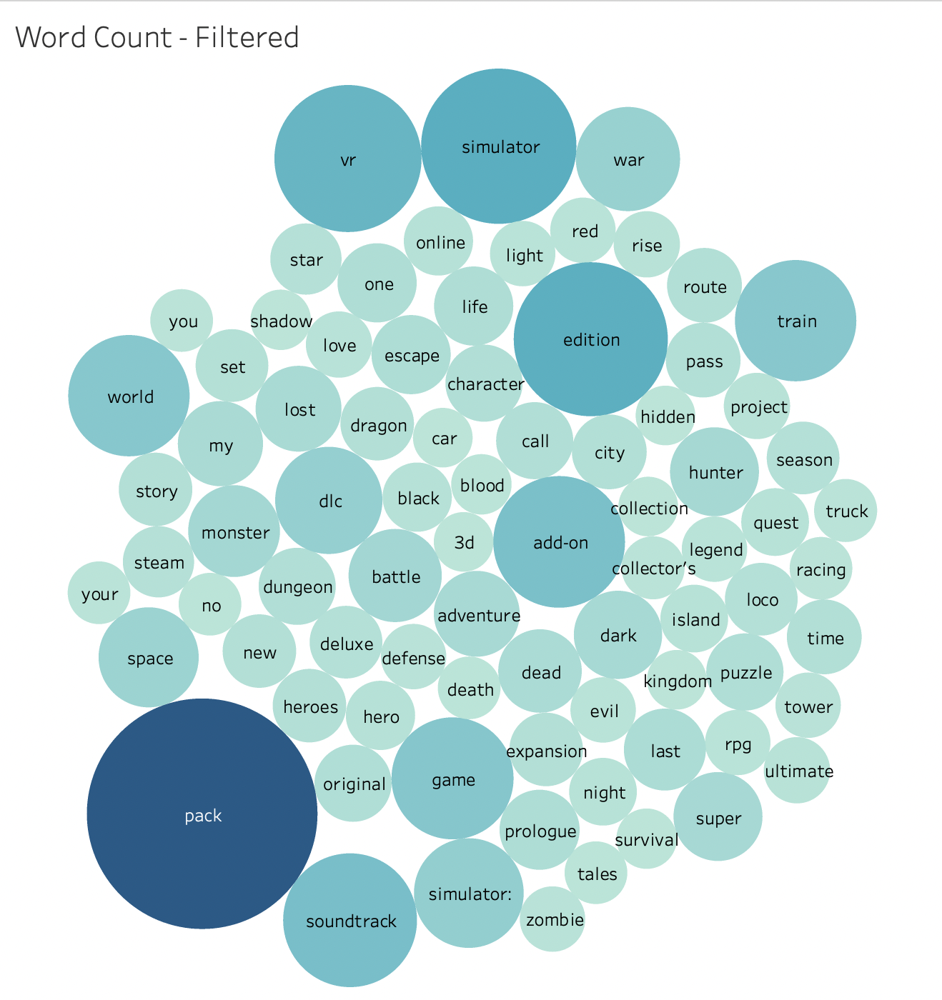
Word Count : Filterd
Tableau Visualization
Most Frequent
Pack
Simulator
Edition
VR
:
:
:
:
2,270
1,030
1,013
924
Interesting Words
Fantasy
Physical
Astronomy
Automobile
:
:
:
:
Monster, Zombie
Dungeon, Hero
War, Battle, Death, Dead, Survival
Star, Space
Truck, Racing, Car

Slide 16
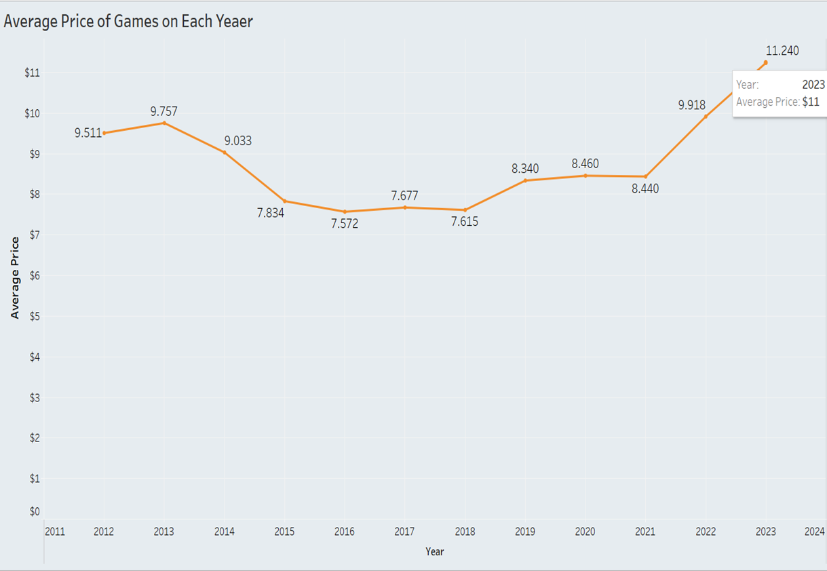
Problem 2: Time Series Analysis
[Average Game Price in Every Year]
Based on this time-serial price trend, game developers can set prices for their games at least meeting the average ones.
The average game price has increased to around $11 in the past three years. The reason for this is uncertain but we can guess that game prices might have been affected by inflation in most of countries.

Slide 17
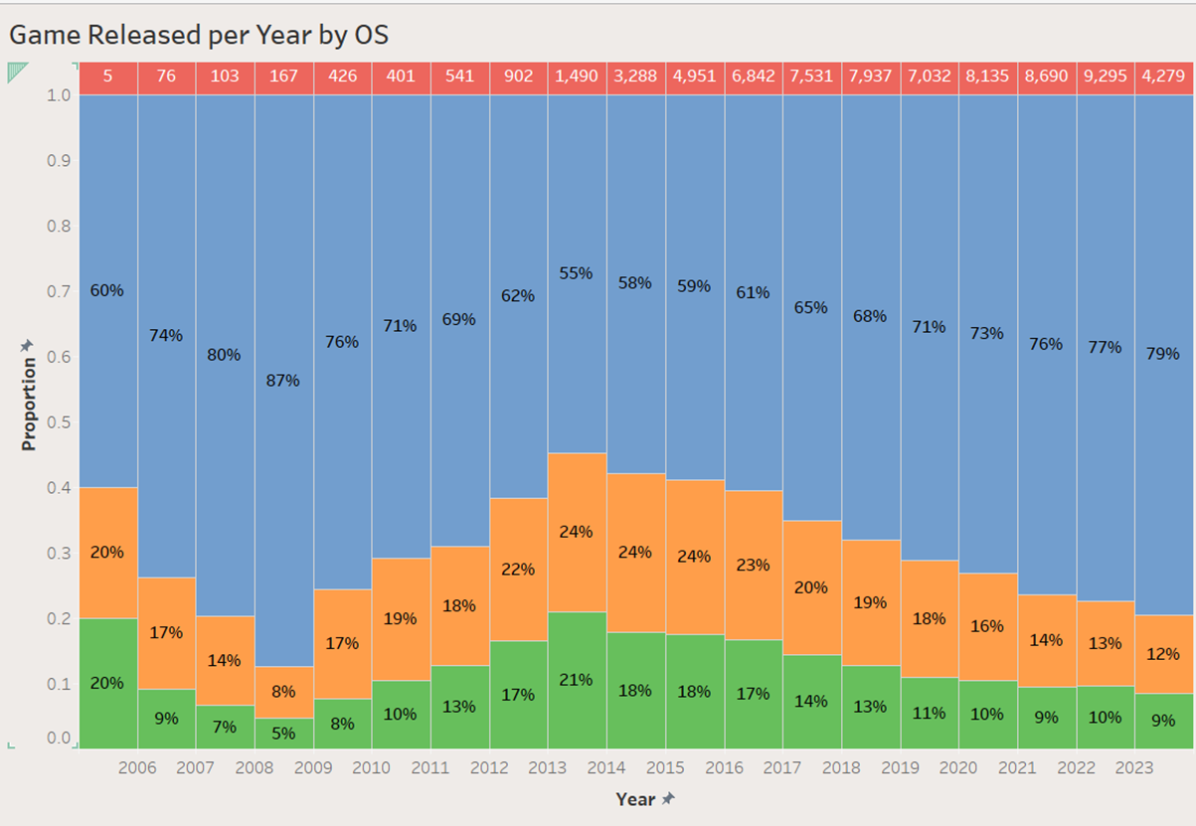
Problem 2: Time Series Analysis
[Games Released per Year by OS]
The number of games released per year has significantly increased since 2012.
Between 2012 and 2017, games released on Mac and Linux account for about 22% and 17%, respectively.
However, the proportions of Mac and Linux have continuously decreased up to 12% and 9%, respectively. On the other hand, the market share of Windows has become predominant.

Slide 18
Problem 3: More Products, More reviews?
In the linear regression model provided by calculated, the intercept is 0.24793,
means that if a user owns zero games, the model would predict that they would write approximately 0.24793 reviews
Number of Reviews=0.24793+(slope×Number of Games Owned)

Slide 19
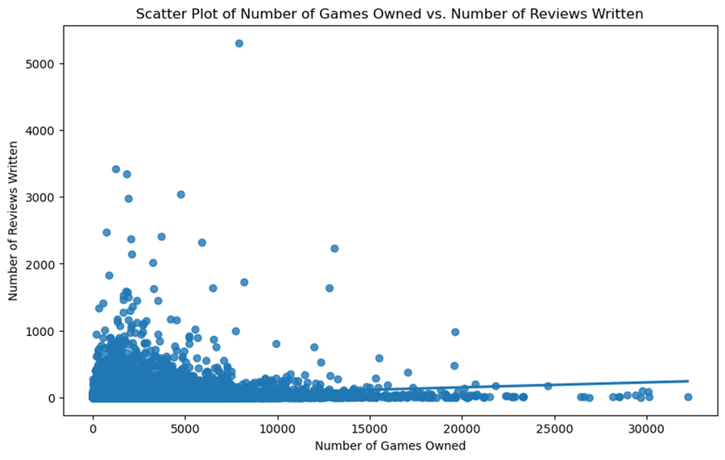
Problem 3: More Products, More reviews?
Data shows that as the number of owned games increases, there's a corresponding gradual increase in the number of reviews, with most figures ranging between zero and 5000.

Slide 20
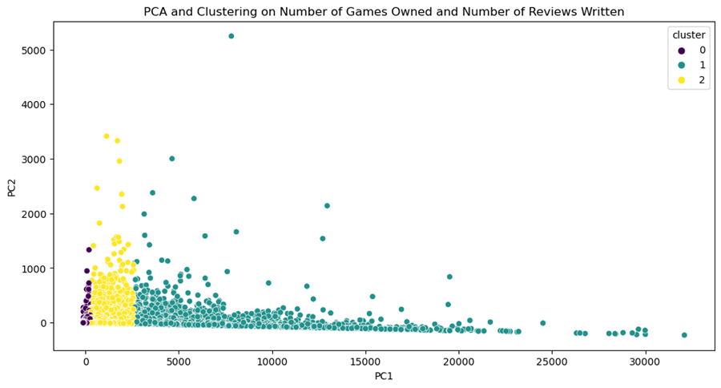
Problem 3: More Products, More reviews?
PCA is a dimensionality-reduction method that is used to reduce the number of variables in a data set while preserving as much information as possible.

Slide 21
Problem 3: More Products, More reviews?
Cluster 0 (Dark Blue): Represents users with fewer games and reviews.
Cluster 1 (Green): Represents users with a moderate number of games and reviews.
Cluster 2 (Yellow): Represents users with a large number of games and reviews.

Slide 22
Problem 3: More Products, More reviews?
The clustering indicates distinct user groups on Steam, with a trend showing that users who purchase more games are more likely to write reviews.

Slide 23
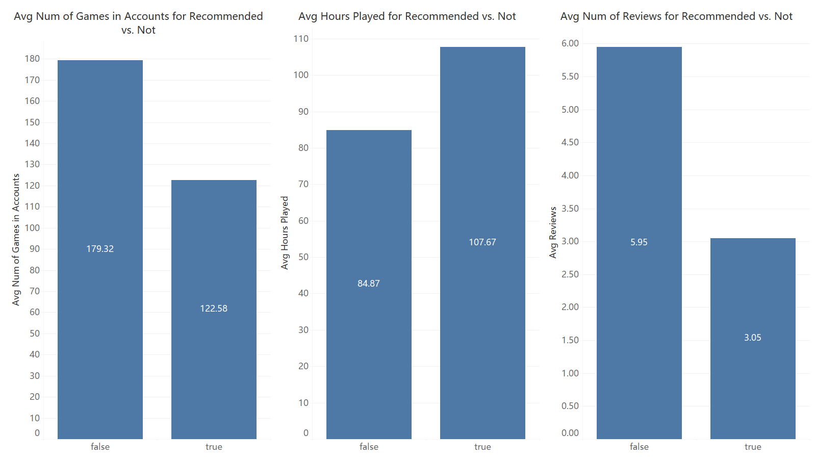
Problem 4: What kind of player are most likely to give a recommendation
Interesting Pattern
Hypothesis:
Players have less game in account tend to say no?
The more players play a game, the more likely they are willing to recommend the game?
Players have previously left more comment are less likely to recommend the game?

Slide 24
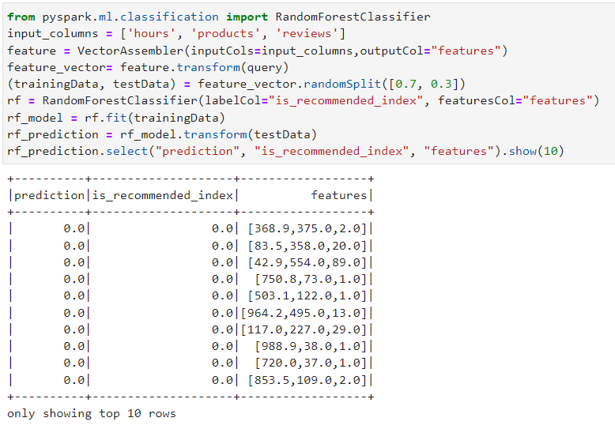
Analyze Process: Machine Learning Algorithm and Predictors
Use Random Forest Model to predict. The predictors selected are hours players have played the game, products they have in their account and reviews they have left before

Slide 25
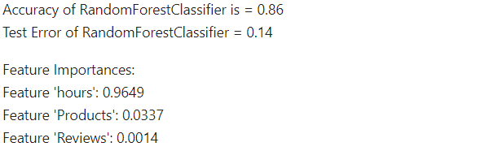
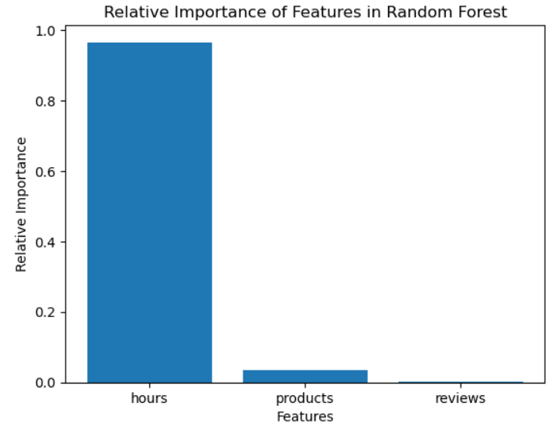
Result and Conclusion
Test error
The test error of the analyze is decent, only 0.14
Importance of predictors
As the image shows right, the most important variable is hours player played.
Basically, the more players played the game the more they will comment a recommendation finally

Slide 26
05
CONCLUSIONS

Slide 27
CONCLUSIONS
Engagement Drives Recommendations: The pivotal factor for game recommendations on Steam is player engagement, quantified by hours played.
Model's Performance: Our predictive model achieved a test error rate of 0.14, indicating reliable accuracy in forecasting recommendations.
Implications for Developers: These insights can guide developers and marketers to focus on enhancing user engagement to boost game recommendations.
Affirmation of Big Data's Value: The use of Big Data tools has been instrumental in deriving these insights, demonstrating their effectiveness in analyzing complex user interaction datasets.

Slide 28
THANKS!
Q&A

